Slide 1
Cost of Living Index by Country
Staci McDuffie
03/01/2025
DSC530: Data Exploration and Analysis
Term Project

Slide 2
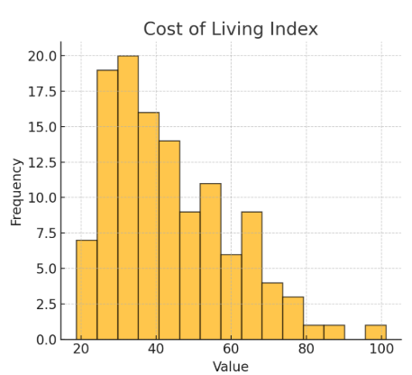
Variable 1: Cost of Living Index
Cost of Living Index - Appears to be right-skewed, indicating a few countries with significantly higher costs of living.
Cost of Living Index: The mean is 43.56, with a maximum value of 101.1. The distribution is right-skewed.
The mean of the Cost-of-Living Index is 43.555372, the standard deviation is 16.147574 and the mode is 26.4.
The Cost-of-Living Index has a minimum value of 18.8 and a maximum value of 101.1.
The Cost-of-Living Index has 30.2 of its data that lies in the 25% percentile, 39.5 that lies in the 50% percentile and 52.8 that lies in the 75% percentile.

Slide 3
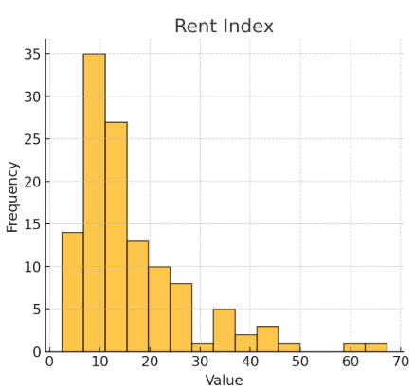
Variable 2: Rent Index
Rent Index - Skewed distribution with some high outliers.
Rent Index: The mean is 16.05, but there is a significant variation, with a maximum value of 67.2.
The mean for the Rent Index is 16.052893, the standard deviation is 11.412267 and the mode is 7.7.
The Rent Index has a minimum value of 2.4 and a maximum value of 67.2.
The Rent Index has 8.5 of its data that lies in the 25% percentile, 12.4 that lies in the 50% percentile and 20.1 that lies in the 75% percentile.

Slide 4
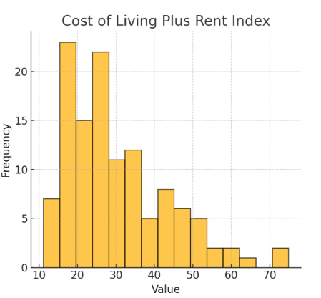
Variable 3: Cost of Living Plus Rent Index
Cost of Living Plus Rent Index - Similar shape to the Cost-of-Living Index.
Cost of Living Plus Rent Index: Mean is 30.36, with a range between 11.1 and 74.9.
The mean for the Cost of Living Plus Rent Index is 30.357851, the standard deviation is 13.263721 and the mode is 18.9.
The Cost of Living Plus Rent Index has a minimum value of 11.1 and a maximum value of 74.9.
The Cost of Living Plus Rent index has 19.8 of its data the lies in the 25% percentile, 27.0 that lies in the 50% percentile and 37.0 that lies in the 75% percentile.

Slide 5
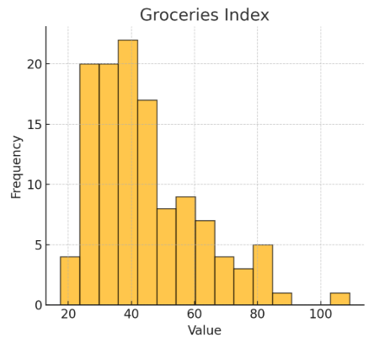
Variable 4: Groceries Index
Groceries Index - Somewhat normal distribution but with a few outliers.
Groceries Index: Mean is 44.23, with a maximum of 109.1, indicating high variation in grocery costs across countries.
The mean for the Groceries Index is 44.228926, the standard deviation is 17.055109 and the mode is 25.4.
The Groceries Index has a minimum value of 17.5 and a maximum value of 109.1.
The Groceries Index has 31.6 of its data that lies in the 25% percentile, 40.5 that lies in the 50% percentile and 53.7 that lies in the 75% percentile.

Slide 6
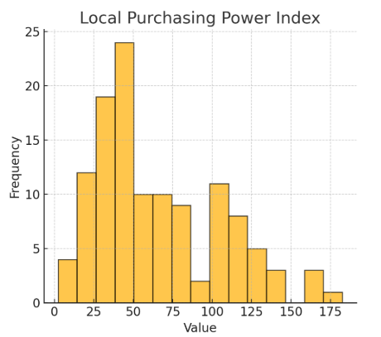
Variable 5: Local Purchasing Power Index
Local Purchasing Power Index - Has a widespread with some extreme values.
Local Purchasing Power Index: Mean is 65.09, but the standard deviation is high, reflecting large differences in purchasing power.
The mean for the Local Purchasing Power Index is 65.094215, the standard deviation is 39.569094 and the mode is 25.4.
The Local Purchasing Power Index has a minimum value of 2.3 and a maximum value of 182.5.
The Local Purchasing Power Index has 34.8 of its data that lies in the 25% percentile, 50.6 that lies in the 50% percentile and 99.4 that lies in the 75% percentile.

Slide 7
Outliers
Cost of Living Index: The highest value of 101.1 (Switzerland) is an extreme outlier.
Rent Index: Countries with values above 60 (e.g., Singapore) are outliers.
Groceries Index: A max value of 109.1 indicates possible extreme cases.
Local Purchasing Power Index: Values above 150 (e.g., Switzerland) represent strong deviations.
How to handle Outliers
These outliers represent real-world differences rather than data errors. Instead of removing them, I will use transformations like log normalization for better interpretation.

Slide 8
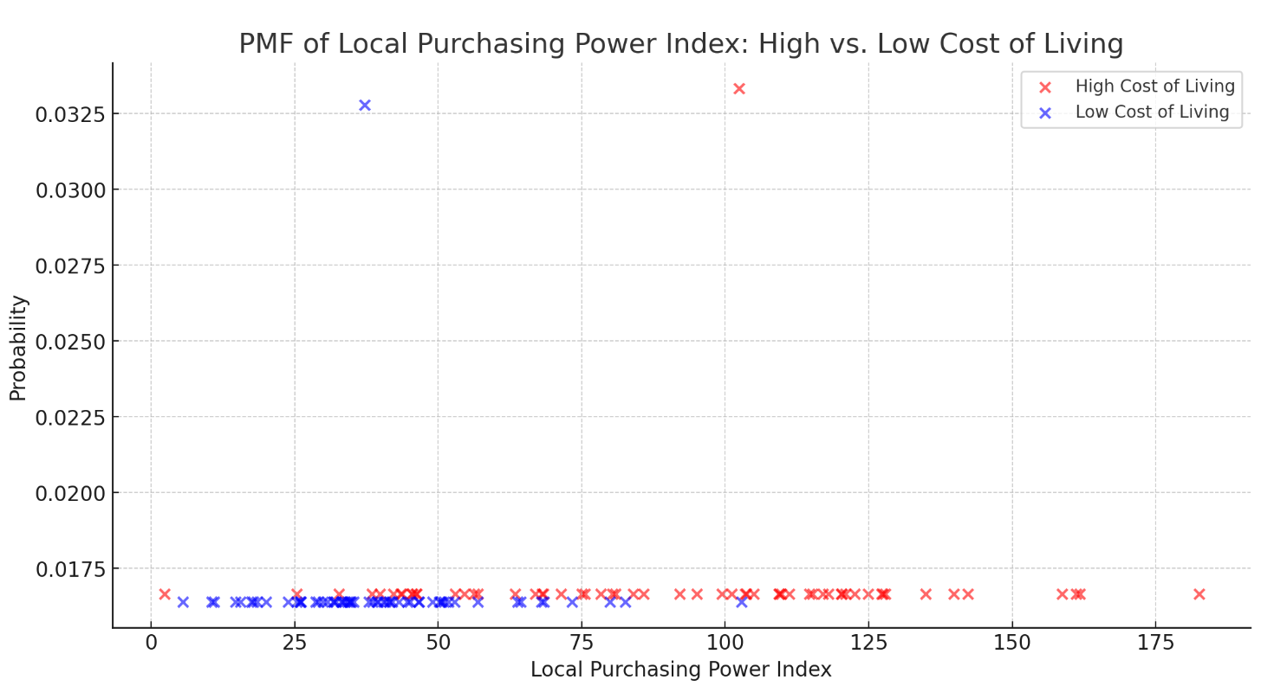
PMF of Local Purchasing Power Index: High vs Low Cost of Living
The PMF comparison shows the probability distributions of the Local Purchasing Power Index for countries with high and low Cost of Living Index values.
High Cost of Living Countries tend to have more varied purchasing power, with some having high purchasing power while others have significantly lower values.
Low Cost of Living Countries generally have their purchasing power clustered toward lower values.
This suggests that higher costs of living do not necessarily guarantee lower purchasing power, as some countries such as Switzerland, have both a high cost of living and high purchasing power.

Slide 9
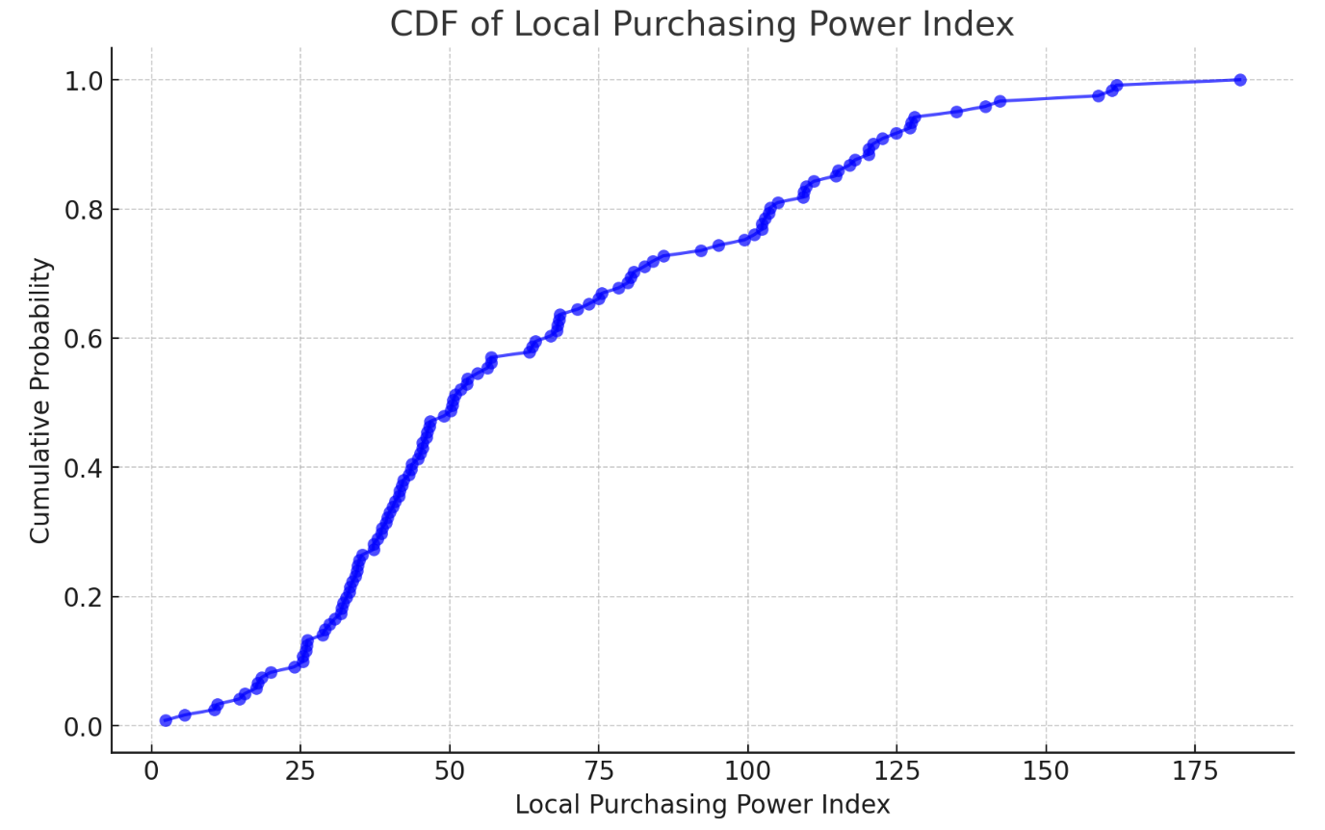
CDF of Local Purchasing Power Index
The Cumulative Distribution Function (CDF) of the Local Purchasing Power Index provides insight into the distribution of purchasing power across countries.
The steepest region represents the most common purchasing power values. Around 50% of the countries have a Local Purchasing Power Index below 50, indicating that purchasing power is relatively low in many nations.
The right tail extends significantly, showing a few countries with extremely high purchasing power.
This visualization helps address our statistical question by showing that while some high-cost-of-living countries have strong purchasing power, many do not.

Slide 10
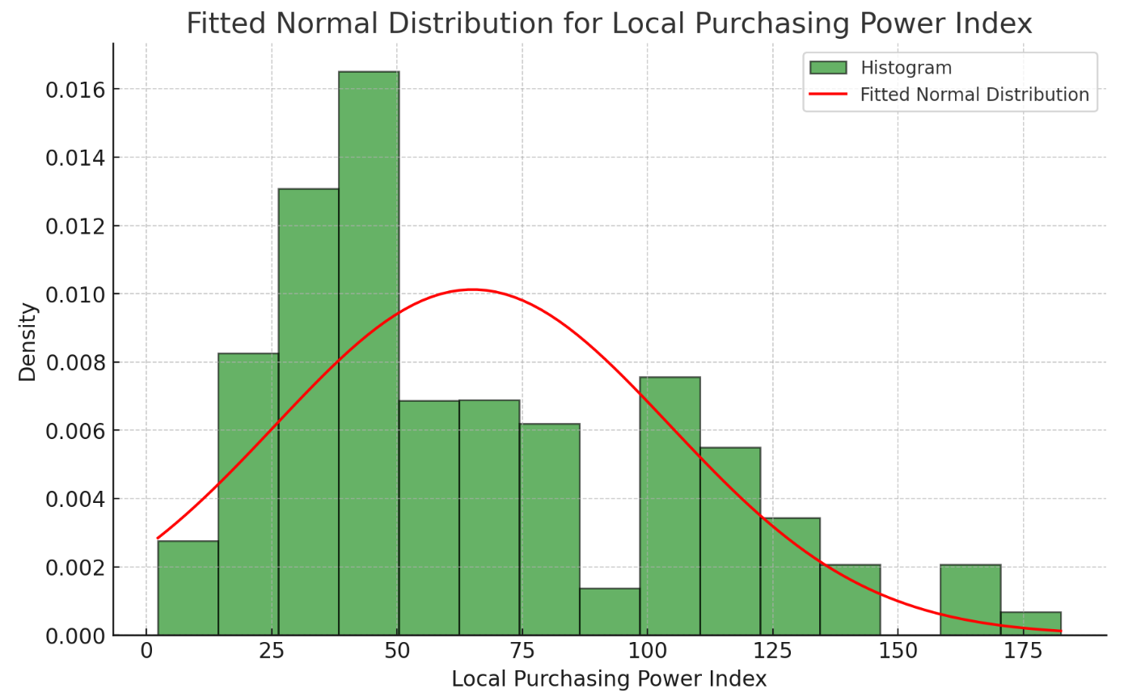
Fitted Normal Distribution for Local Purchasing Power Index
The fitted normal distribution for the Local Purchasing Power Index shows that the data is not perfectly normally distributed, as the histogram has skewness and heavy tails.
The right tail is extended, suggesting that some countries have exceptionally high purchasing power.
Despite deviations, a normal approximation is useful for statistical inference.
This suggests that while a normal model can provide a rough estimate, a log-normal or gamma distribution might be a better fit dues to the skewness.

Slide 11
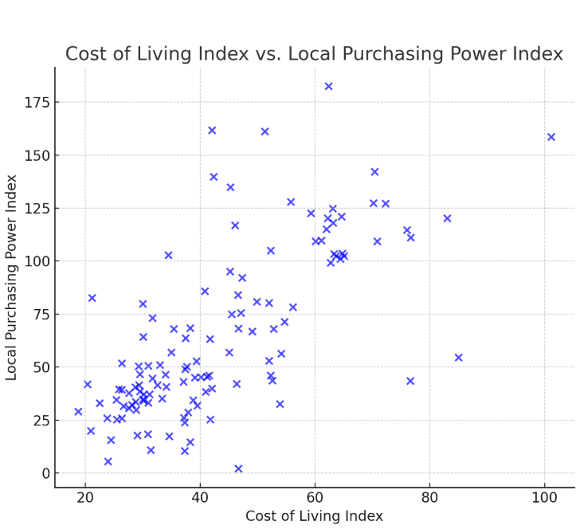
Rent Index vs Cost of Living Plus Rent Index
The Cost-of-Living Index vs. Local Purchasing Power Index shows no strong linear correlation.
Some high-cost countries have very high purchasing power, while others have very low.
This suggests that high cost of living does not always mean lower purchasing power.

Slide 12
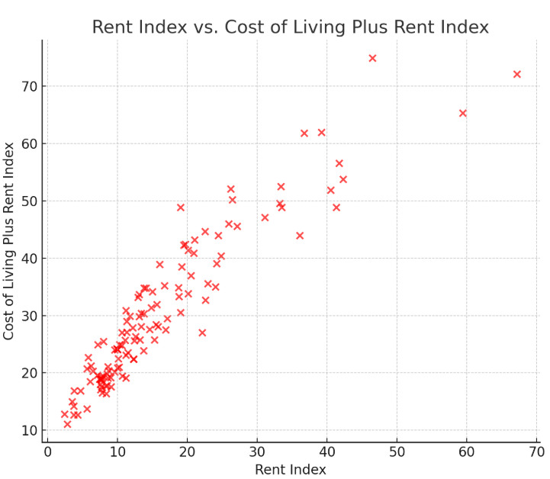
Rent Index vs Cost of Living Plus Rent Index
The Rent Index vs Cost of Living Plus Rent Index shows a strong positive correlation that is evident.
Higher rent costs directly increase the overall cost of living.

Slide 13
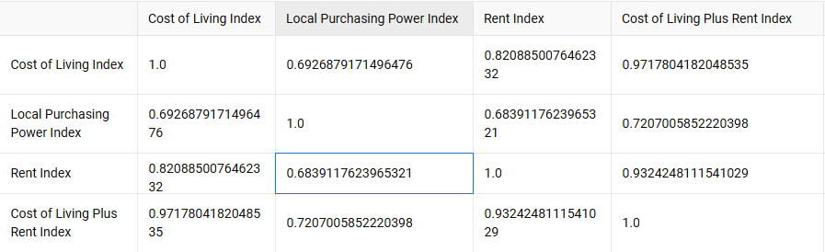
Correlation Matrix
The Pearson correlation coefficient between Cost of Living Index and Local Purchasing Power Index is 0.69, indicating a moderate positive correlation.
The p-value is extremely small, meaning this result is statistically significant.
This contradicts the hypothesis that higher living costs necessarily reduce purchasing power. Instead, some high-cost countries also have strong purchasing power.

Slide 14
Multiple Linear Regression
The model explains 52.4% of the variance in Local Purchasing Power Index (R^2 = 0.524), meaning other factors also influence purchasing power.
Cost of Living Index has a significant positive effect on purchasing power (p= 0.015), meaning countries with higher living costs tend to have higher purchasing power.
Rent Index is also positively associated with purchasing power (p = 0.003), suggesting that expensive rent is linked to stronger economies.
Groceries Index does not significantly impact purchasing power (p = 0.331), meaning grocery prices alone are not a strong predictor.
This analysis challenges the assumption that a high cost of living always reduces purchasing power. Instead, higher living costs often correlate with stronger economies.

